Slide 1

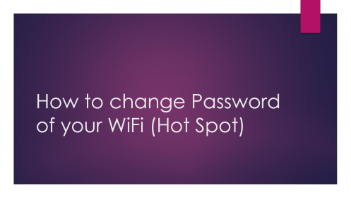
Digital Literacy Assignment

Slide 2
How to change Password of your WiFi (Hot Spot)

Slide 3
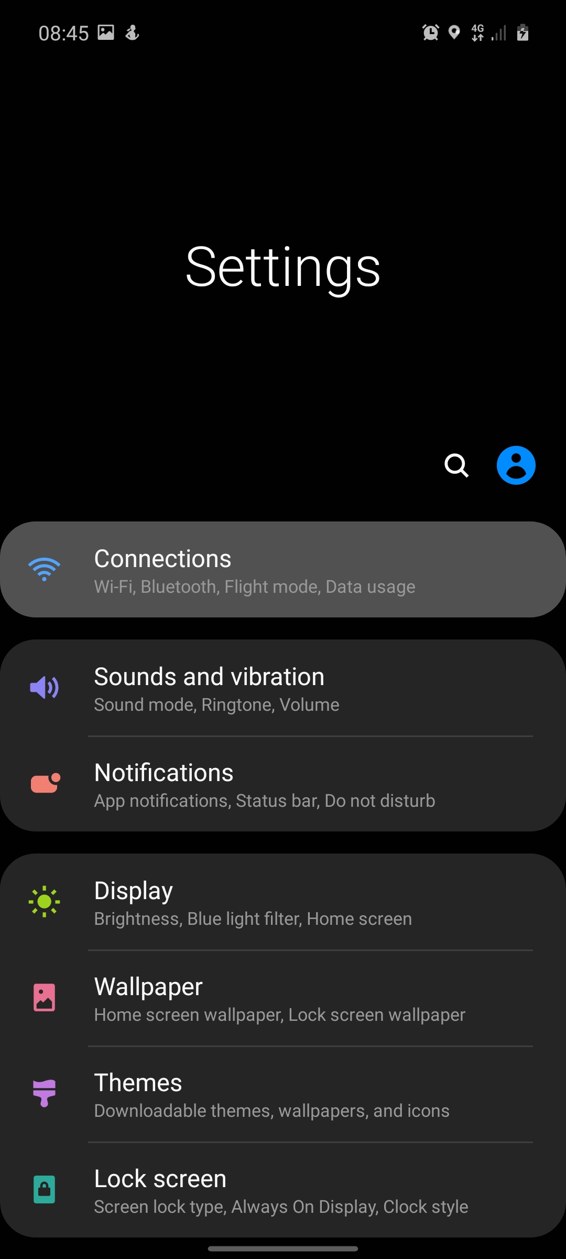
Open Settings
In settings choose Connection setting.

Slide 4
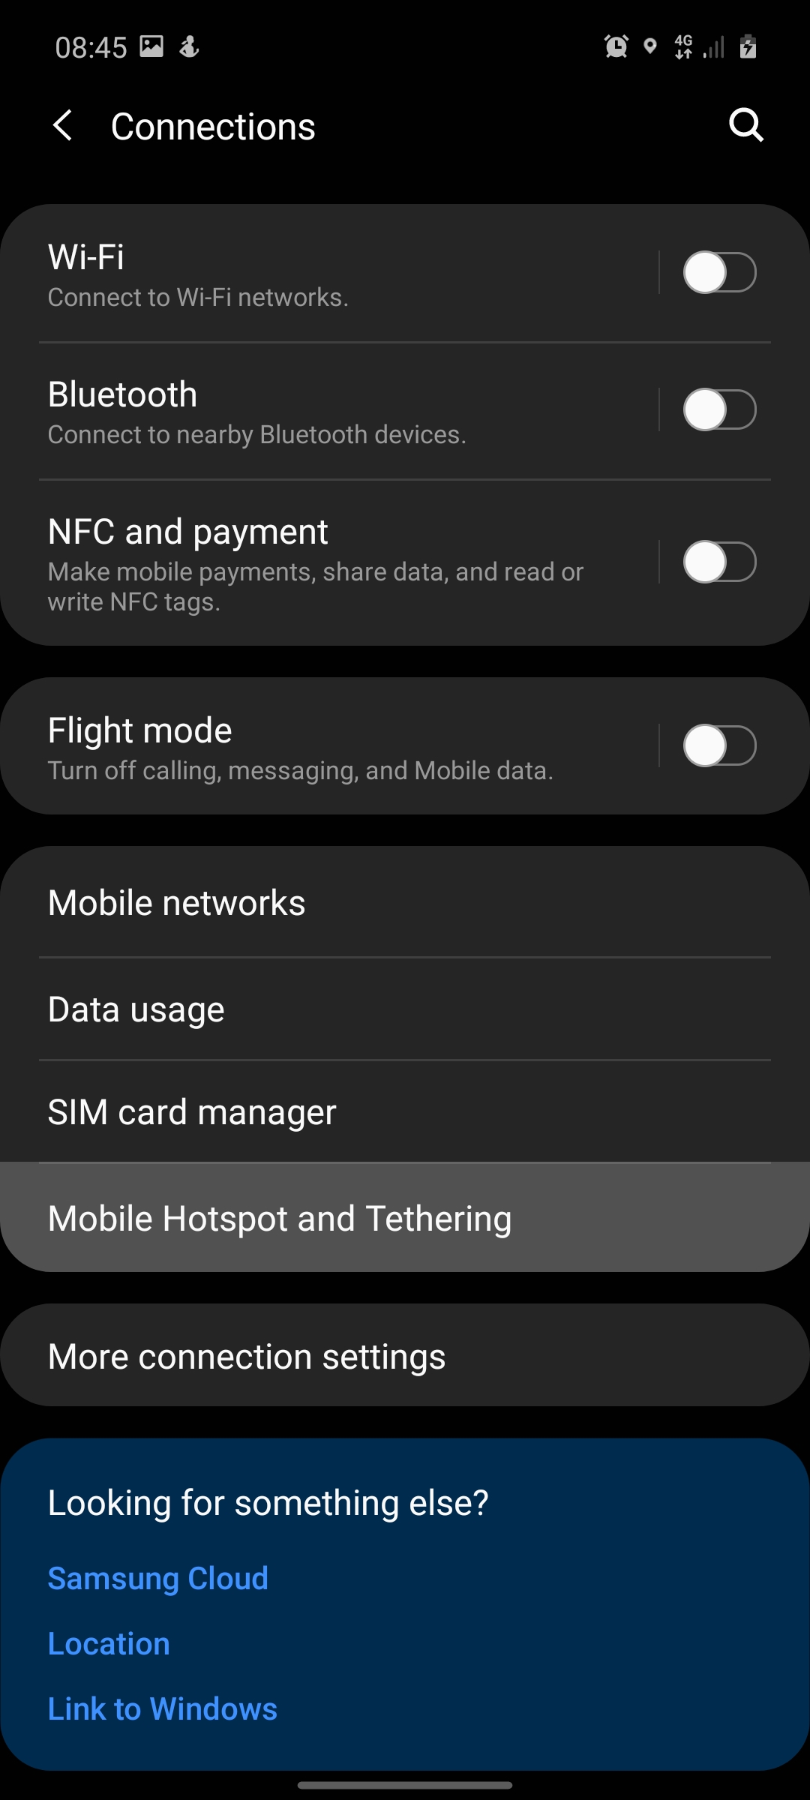
In Connections
Open Mobile Hotspot and tethering

Slide 5
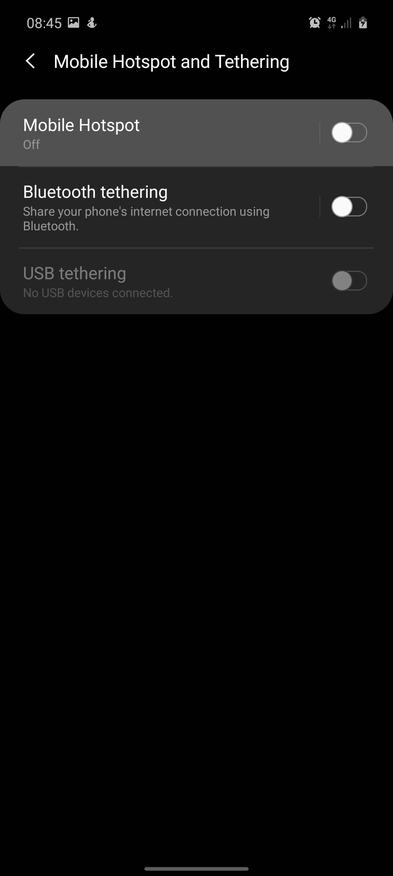
In Mobile Hotspot and Tethering
Open Mobile Hotspot

Slide 6
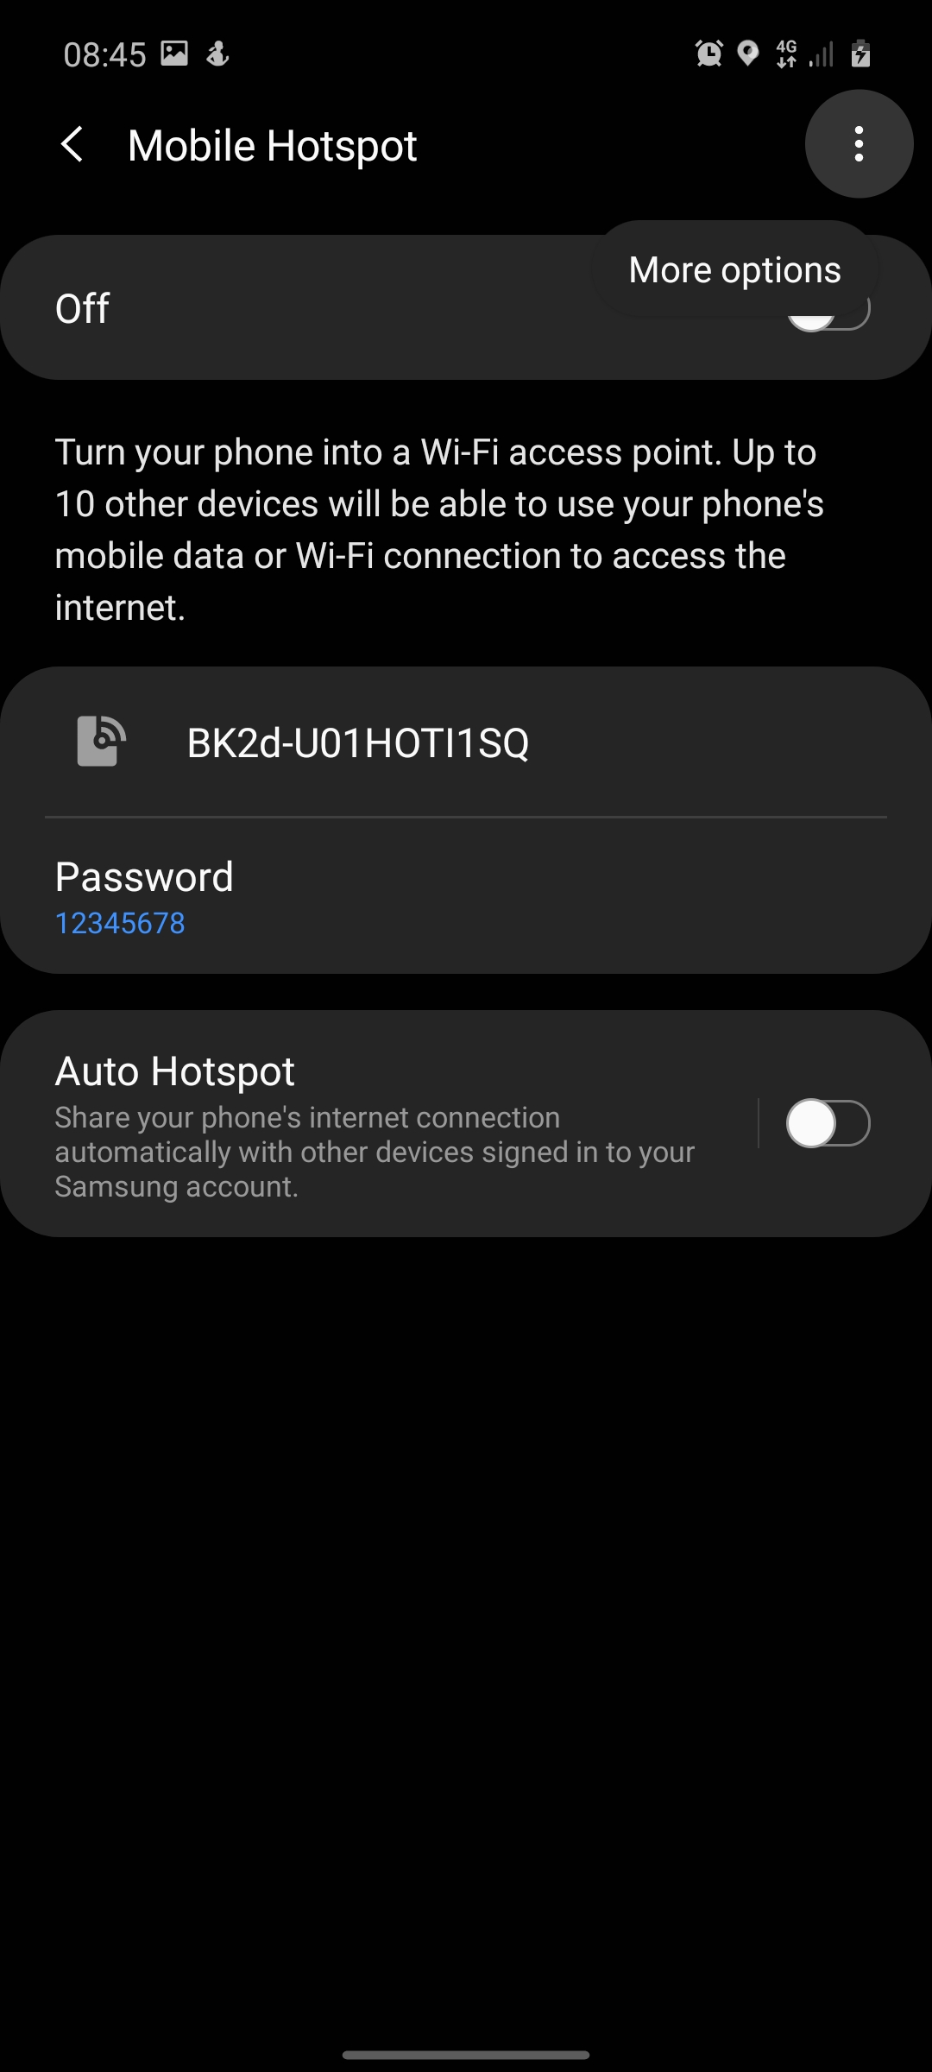
In Mobile Hotspot
Click on top right corner for more options

Slide 7
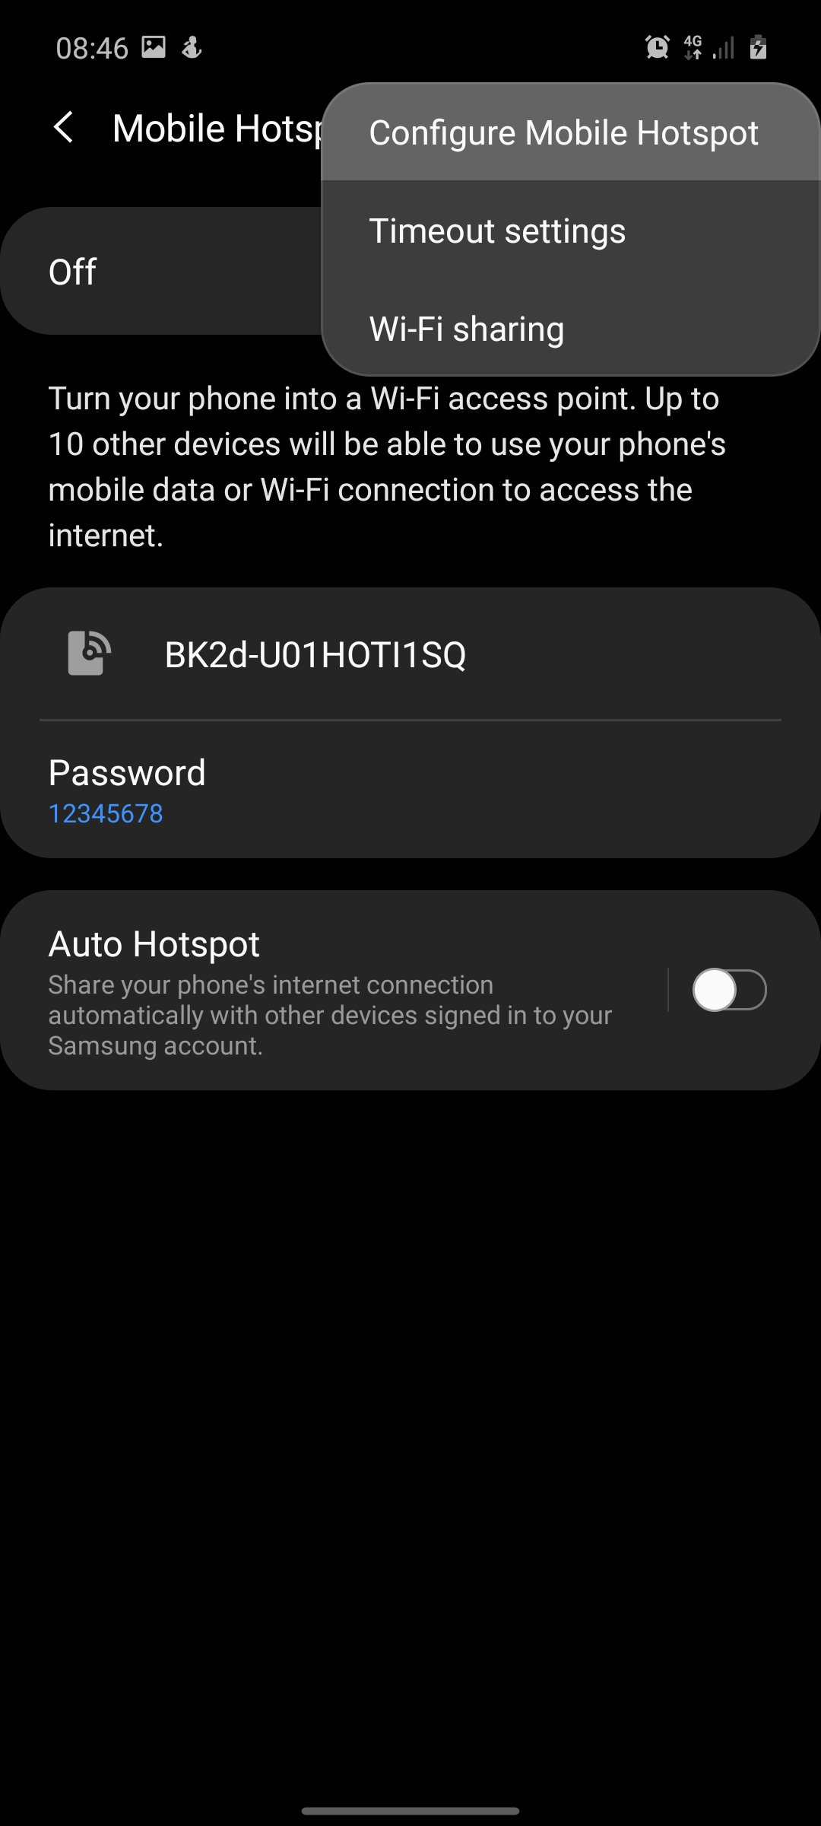
In More Options
Choose Configure Mobile Hotspots

Slide 8
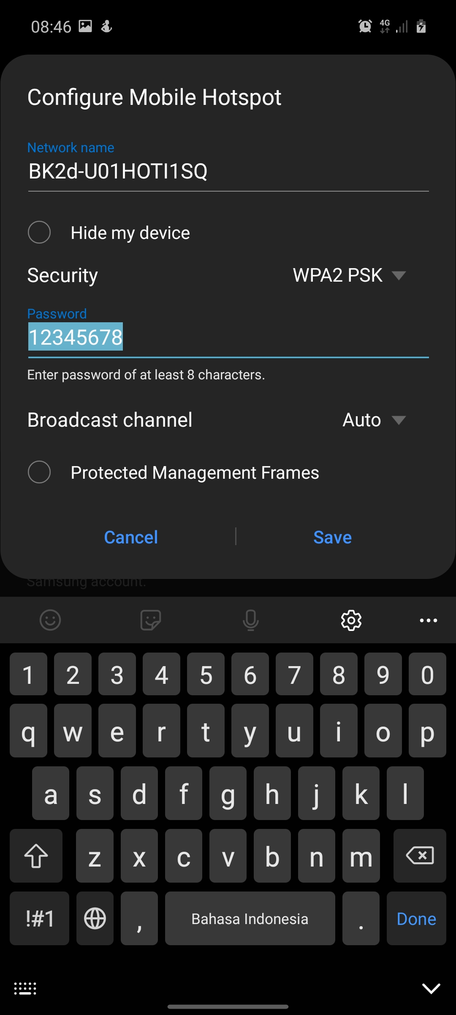
In Configure Mobile Hotspots
On password option change your password you can also change your network name or type of security you want to use

Slide 9
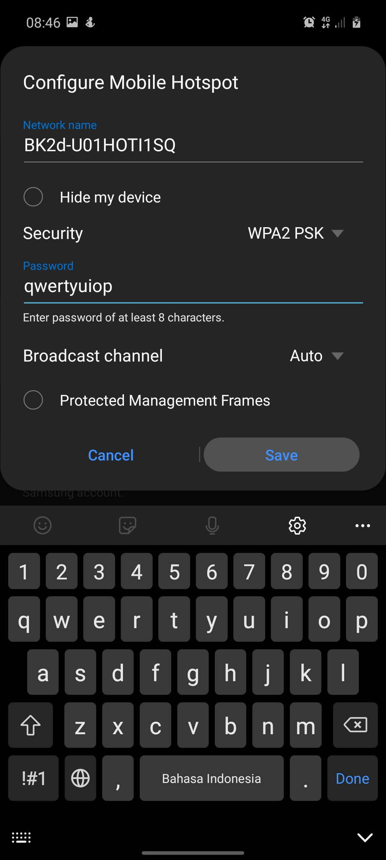
In Configure Mobile Hotspots
After you change your password then click save and then you are finish.

Slide 10
For Bluetooth Password

Slide 11
Open Settings
In settings choose Connection setting.

Slide 12
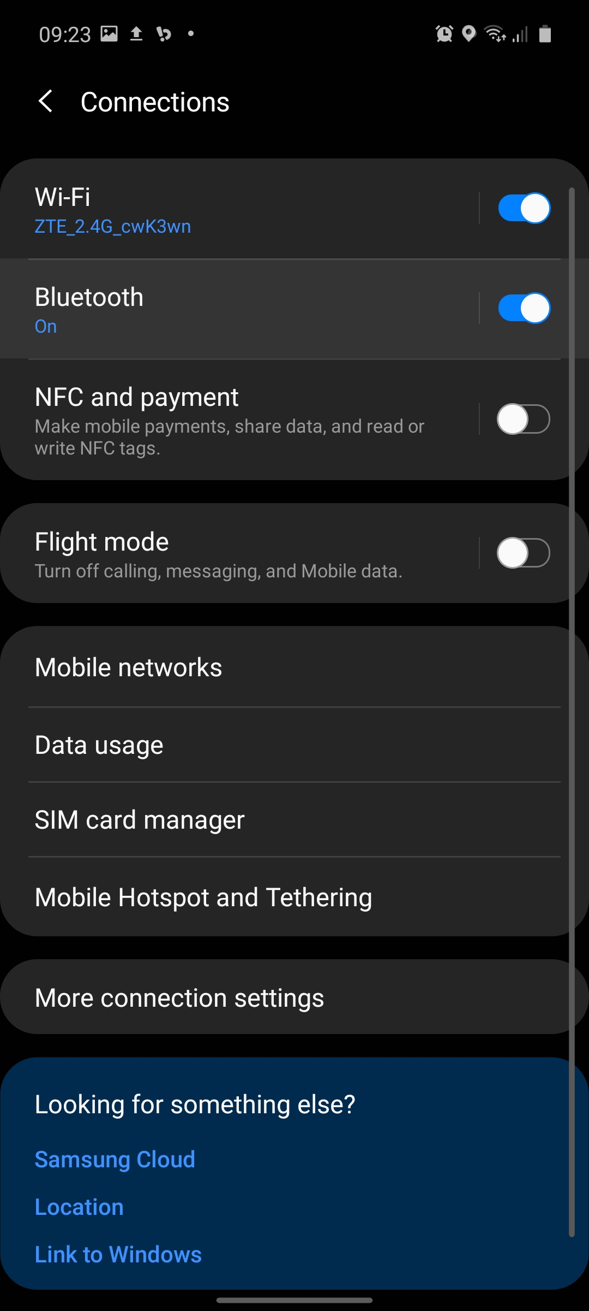
In Connections Settings
On here choose bluetooth

Slide 13
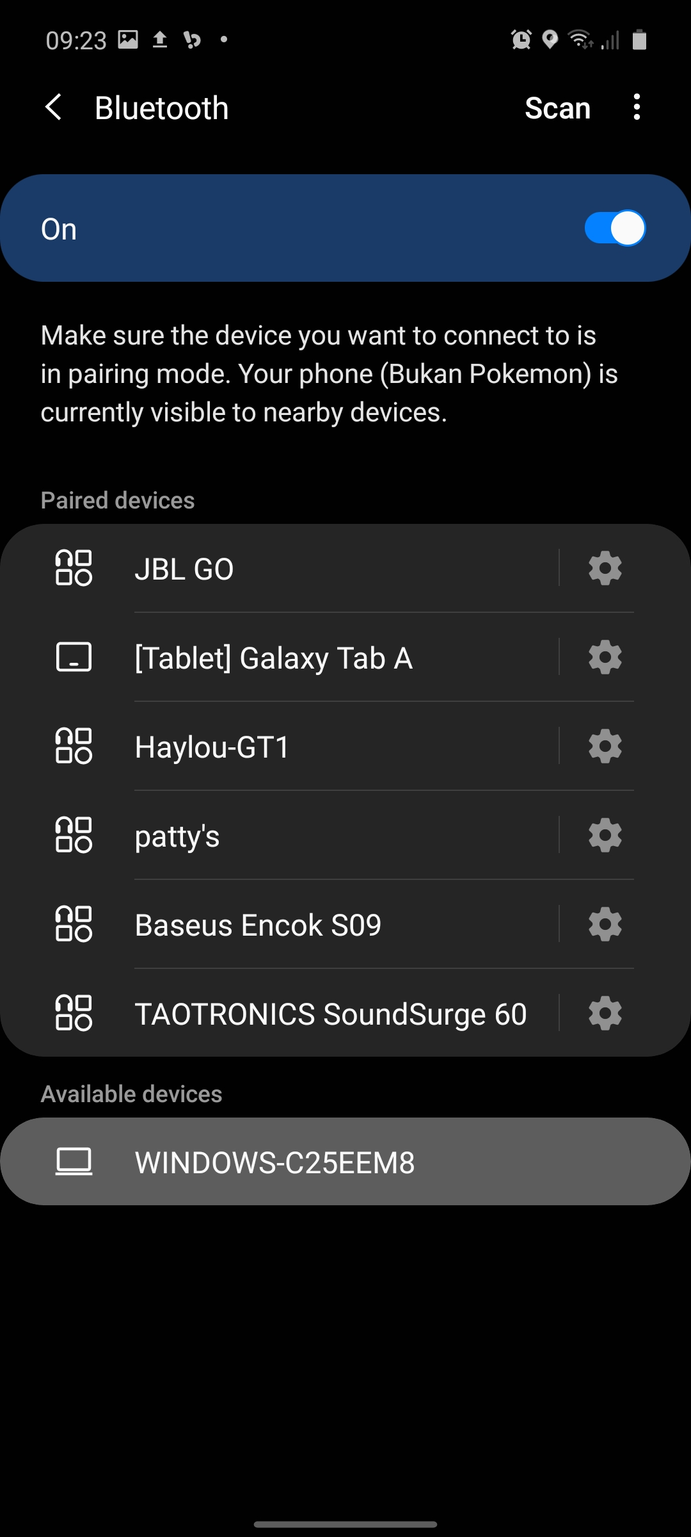
In Bluetooth Settings
Chose the device you want to connect

Slide 14
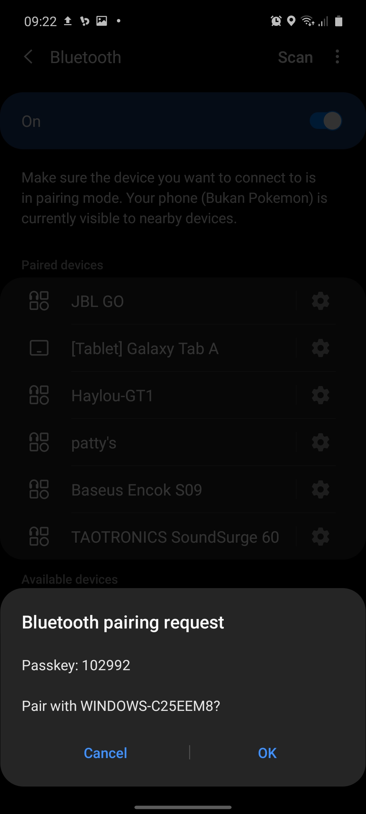
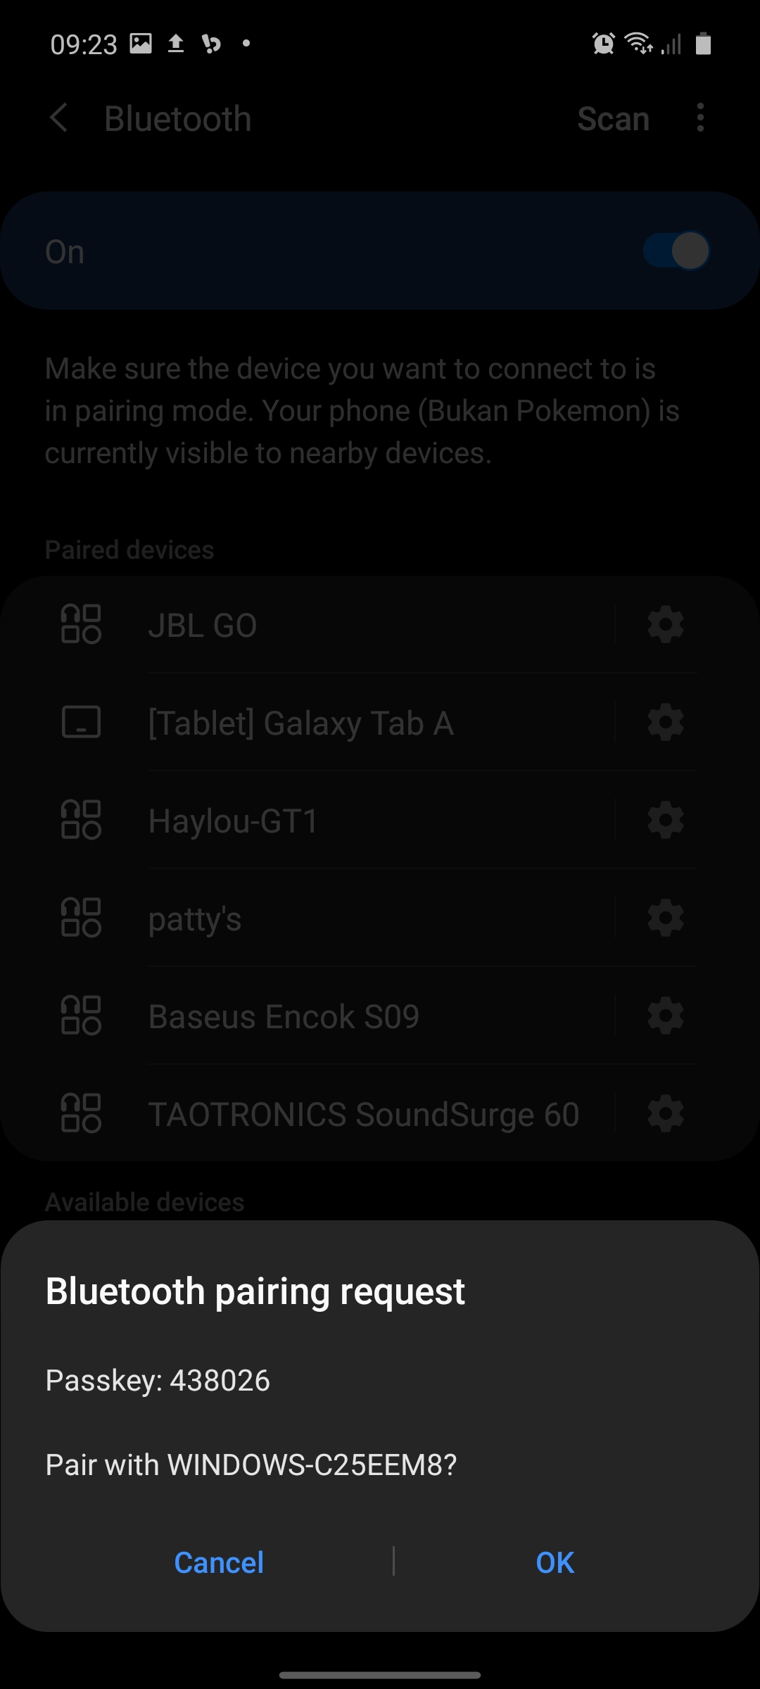
After you click on the device
On here you can see the passkey to pair with other device. So Bluetooth passkey is only use to pair device with other device so you can’t randomly pair to other person Bluetooth device and the passkey always change.So you can’t setup your own passkey password. As you can see the passkey change on the second attempt to pair with the same device.

Slide 15
Thank You

